Slide 1



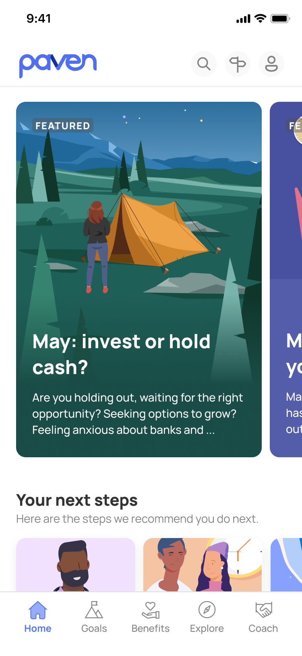

Opportunities in broader wellness

Slide 2


Paven's original focus on Financial Wellness & Benefits domains
Increase employee’s appreciation of benefits
Improve employee’s financial wellbeing
Value drivers
+ Retention
+ Productivity
Paven app
Awareness
Learning about benefits
Understanding of finances
Taking action
Using the benefits
Acting on finances

Slide 3
Explore a broader opportunity within Wellness
Wellness
Helping individuals make choices and behavioral changes that will increase the quality and span of their lives. They have likely struggled to adopt these behaviors consistently.
Fitness
Behaviors:
+Regular movement
+Mobility & Stretching
+Strength & Variety
+Rest & Recovery
Apps
+Apple
+ Google Fit
+ MyFitnessPal
Nutrition
Behaviors:
+Balance diet
+ Portion control
+ Meal timing
+ Hydration
+ Ingredient selction
Apps
+Noom
+Weight Watchers
+Lumen
Mental & Emotional
Behaviors:
+Spirituality
+Stress management
+Mindfulness & meditation
+Emotional regulation
+Self-reflection
Apps
+Headspace (meditation)
+Calm
Social
Behaviors:
+Building relationships
+Maintaining bonds
+Communication
+Work-Life balance
+Community involvement
Apps
+BumbleBFF
+etc
Financial
Behaviors:
+Financial stress
+Debt management
+Long-term planning
+Budgeting & Saving
+Insurance & Estates
Apps
+Paven
+Origin
+Northstar
+ More
Wellness Domains

Slide 4


Instead of b2c, continue to target organizational sponsors of Wellness
Employers
Supporting their employees and contractors for productivity, morale, and retention
Businesses
Supporting their customers to engender goodwill and loyalty
Govt’s
Supporting their citizens to improve lives and health as part of initiatives
+ More
Insurance providers
Unions
Supporting their members to improve lives and engender loyalty
Schools
Supporting their student and faculty to improve lives as part of their mission
Foundations & Charities
Supporting their target populations to improve lives as part of their mission

Slide 5
Paven as a custom content platform for Wellness
Technology + Services
Behavioral design
Using psychological principles to guide user actions, and designing interfaces that encourage certain behaviors or habits.
Unique & differentiated content
Particular style, tone, and visual effect that is specific to the domain.
Personalization
Content tailored or personalized for specific users or groups based on their preferences, behavior, and circumstances.
Interactive content
Support learnings styles involving doing, rather than consuming text or videos.
Relational content
Recommending content based on relational analysis among concepts in a text.
Dynamically generated content
Generating content
Notes:
Transactional vs Holistic

Slide 6
What are Paven’s 4Q24 priorities given this broader opportunity?
Preserve contract with Meta
Continue to improve engagement and evolve tech/content
FinWell - Meta still views and evaluates Paven primarily on this dimension
Benefits promotion – Meta views as an unproven value prop big potential (and a bonus to FinWell)
Top priority
Develop capabilities on Behavior Change & Custom Content
Position ourselves for opportunities in broader wellness space
Case studies and research – drive business value for client and then document, measuring outcomes
Expertise in tooling & services – iterate, experiment to learn and consolidate for other wellness domains
Support exploration by other teams – consult with teams exploring similar spaces
Next priority
GTM on a specific domain
Multi-tenancy
Deep investment into FinWell or Benefits – beyond what is necessary to preserve Meat contract
Paused
Notes:
Structure into Content
Structure into Product management
Structure into Mission objective
Start with Mission objective
Wellness is about behavior
Baseline behavior, root cause of behavior, determine mechanism addressing root cause, that achieves the outcome
How to do we balance frequency/duration of engagement vs demonstrated behavior change
Nasdaq PM said the Serach pages need to be stickier – but that should not the metric. Search should be as fast as possible, need to measure
Demonstrate how much you helped someone complete an action or journey
Ask Meta their highest priority journey, possibly new hire onboarding? maybe the solution doesn't immediately go into the Paven app shell
How do we balance finwell vs benefits?
Protect Paven brand on FinWell. What we have learned from Paven/Meta, there is a big need to cross selling benefits.
Perhaps do #1 New Hire Onboarding project not within the Paven app shell, then #2 combinatorial value of benefits (cross-functions), then #3 custom package benefits per life moments/journeys
Sandbox for behavioral design
Go back to UST HR, ask for biggest need
Internal projects
Project 1 - Haila, Angie, Vittorio on the methodology for getting people's behavior change: baseline behavior to desired behavior
Project 2 - Haila, how will you use the Paven enviro to understand user need. Determine how much user research we need per year or on some cadence
Project 3 - Angie – what is your content for 5 key journey driving behavior change. Define resources needed
Oct 9 – Analytics meeting
Oct 15 - Northstar meeting – mission objective for 2025 – this is what we're going to become really good at? Why, because there are many opportunities?
Oct 22 -Tactically – what to do in 2024 to prepare for 2025
Dec 5 - What are we going to do for concrete plan for 2025. Only detail is Q1

